Slide 1
Employee Management System
Using Spring MVC and H2 Database

Slide 2
Employee Management System
SUBMITTED BY
Mehul Kumar( 00815931)
Ravikant Upadhyay( 00815930)
MENTOR
Mr. Thaneshwara

Slide 3
Introduction
Employee Management System maintains the information about the personal details of the employee .
It is a distributed application , developed to maintain the details of an employee working in any organization .

Slide 4
Objective Of the Project
This projects aims to simplify the task of maintaining records of the employees of company.
To develop an well-designed database to store employee information.
Provides full functional reports to management of company.
The objective of this project is to provide a comprehensive approach towards the management of employee information

Slide 5
Existing System
Earlier systems were manual where there was no way of properly storing information.
Employee records were stored manually which lead to errors. There was no proper way of tracking employee records.
It is very difficult and required a lot of paperwork which makes the application time consuming and not secured.
There was no administrator which could handle the records. So there was the need to develop a system which could manage all these things and reduce the paperwork

Slide 6
Proposed System
Employee management system is easy to use application which is created to manage the employee data. It is created to record the details of the employees. This reduces the dependency on the manual system which could create errors.
This system can easily help in tracking employee records. There is an administrator which can add, edit, delete and save records in a database. Administrator can view all the employees present in the database.
This employee management system is created completely on the administrative end which means only the admin has access rights to change or modify any records.
So this makes it safe and reliable application to use.

Slide 7
Project Structure
ADMIN : This is the main module in the proposed project . The administrator can read, write , edit and delete information about any employee .
EMPLOYEE MODULE : It contains the details of employee .

Slide 8
Project Flow
Run the Application
Login
yes
If not
Enter username & Password
Register here
See the details of Employee
Edit & Delete
Add Employee

Slide 9
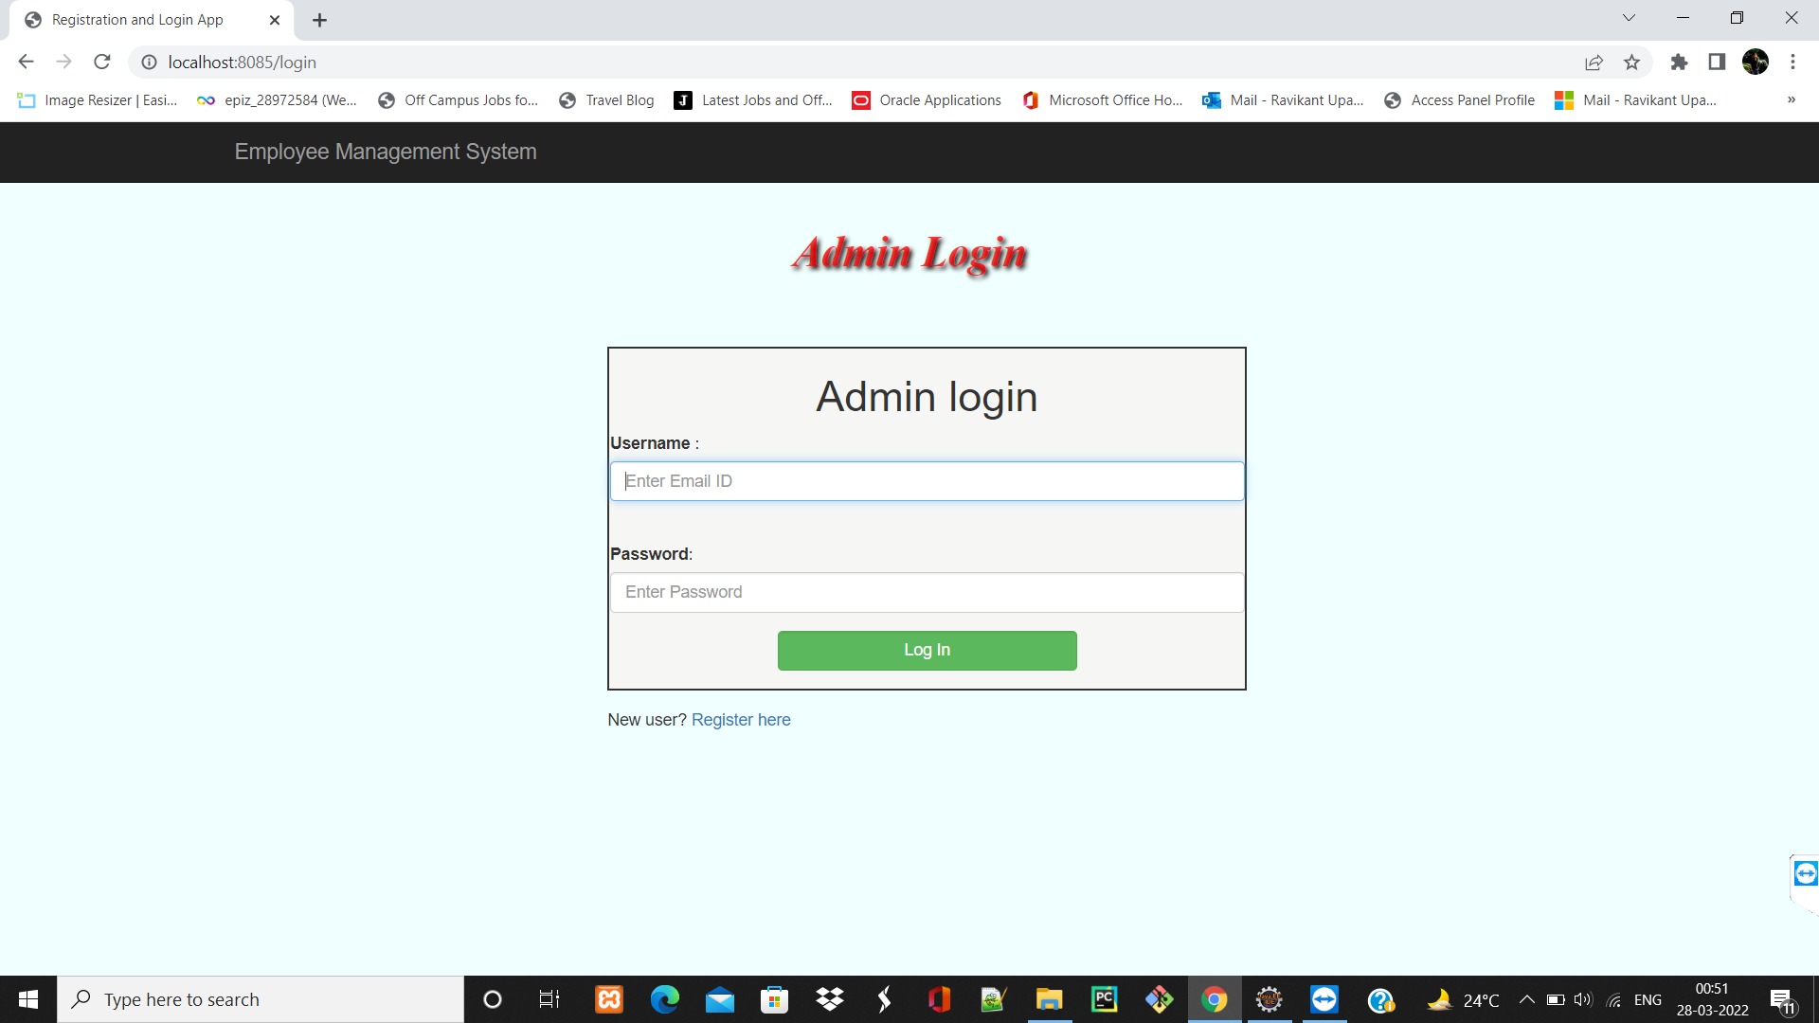
Login Page

Slide 10
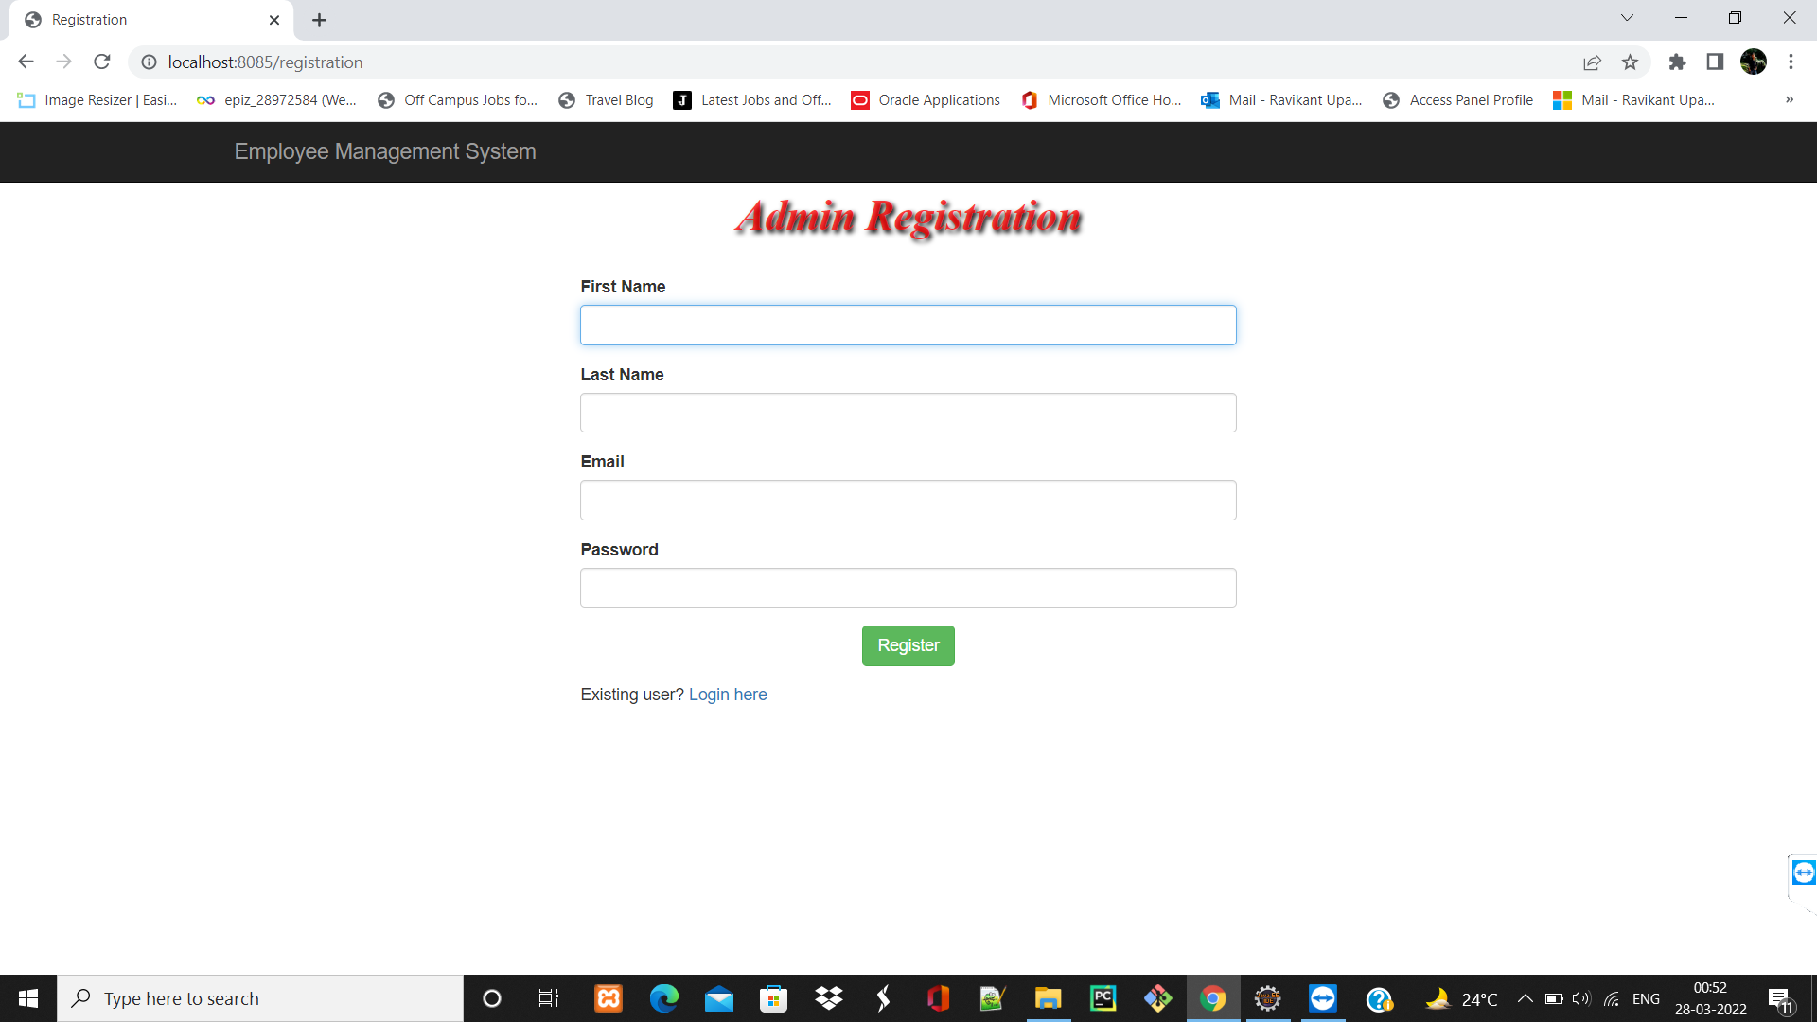
Registration Page

Slide 11
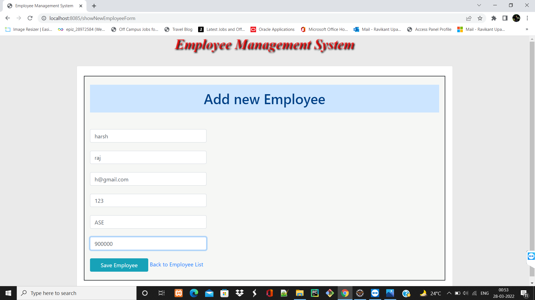
Adding New Employee/Record

Slide 12
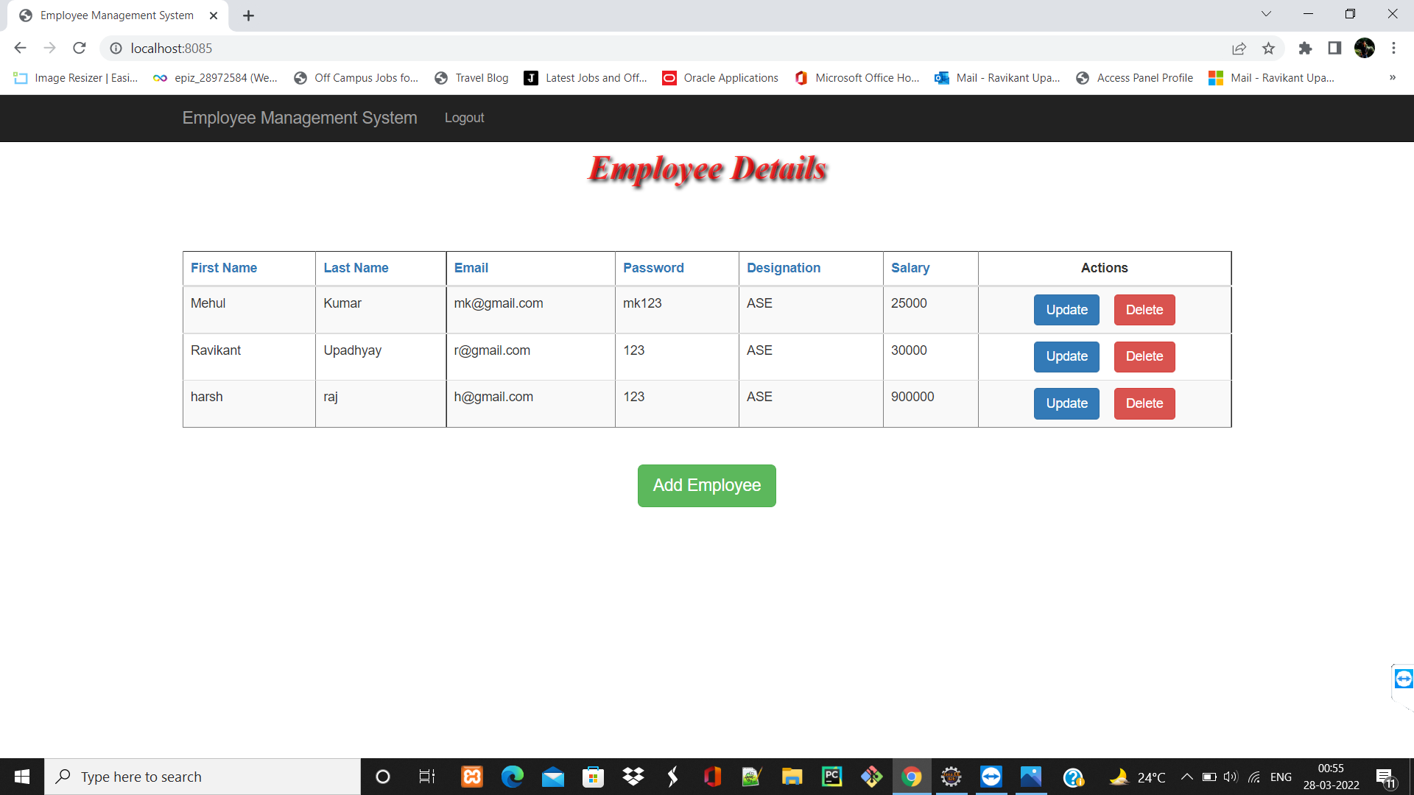
Employee Records

Slide 13
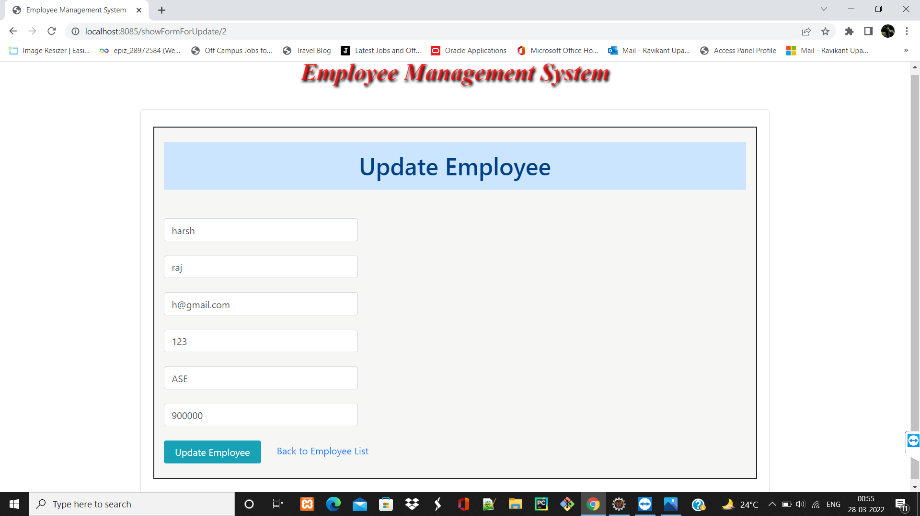
Update/Edit Record

Slide 14
System Requirements
SOFTWARE REQUIREMENT
JRE (JAVA RUNTIME ENVIRONMENT)
HARDWARE REQUIREMENT
PROCESSOR : PENTIUM 2 266MHZ OR HIGHER
RAM : 128 MB OR MORE
HARD DISK : 128MB OR MORE

Slide 15
Features Of The Project
EMS is windows based software . Provides password facility for different users to ensure high level of security .
Single database management system .
User friendly system .
Huge data storage with less computer memory .
More efficient and reliable .

Slide 16
Aadvantages and Disadvantage
Advantages
Easy to Add Employee
Simple update and delete facility.
A simple Employee Management Platform
Easy to use
Disadvantage:
This software will run on a single PC .
Admin and Employee have to sit on the same PC .
No network connection .

Slide 17
Thank you !

